Slide 1

FR A N C E S C O G A B R I E LE DA V I D E M A Z Z A
TH O M A S R O S S O
Wine Price Prediction in Italy: A Data-Driven Study
BU S I N E S S E C O N O M I C AND F I NANCI AL D AT A 2023 - 2024

Slide 2




Objective
EXAMINE PRODUCTION, EXPORTS, CONSUMPTION, AND GRAPE PRODUCTION.
COMPARE DIFFERENT PREDICTIVE MODELS USING VARIOUS PERFORMANCE METRICS
FORECAST FUTURE PRICES USING HISTORICAL DATA

Slide 3



Significance of Italian Wine Industry
Italy is one of the world’s top wine producers and exporters.
In 2022, Italian wine exports reached €7.9 billion, marking a 9.8% increase from the previous year.
The wine sector is crucial for Italy’s economy, with a trade surplus of over €7.3 billion in 2022.
Economic Impact
Why We Chose This Project
Understanding the factors influencing wine prices
Analyzing trends and forecasting to support strategic decision-making
Market Dynamics

Slide 4



Our World in Data
ISTAT
Data collection

Slide 5


Data overview
Time Period Analyzed
1961 – 2022
Analysis spans over 61 years of historical data
Number of Observations
61 annual observations

Slide 6
Data preprocessing
Ensured proper alignment of data over the analyzed period (1961-2021).
Ensures consistency and completeness of the dataset.

Slide 7

Dataset
 |  | Name | Description
 |  | Wine exports | The quantity that is exported in a
 |  |  | given year.
 |  | Wine’s food available for consumption | This measures the quantity that is available for consumption at the end of the supply chain. It does not account for consumer waste, sothe quantity that is actually consumed may be lower than this value.
 |  | Wine production | Wine production per year in italy
 |  | Grapes production | Grapes production per year in italy
 |  | Wine prices | Average prices per liter of the wine in italy per year

Slide 8
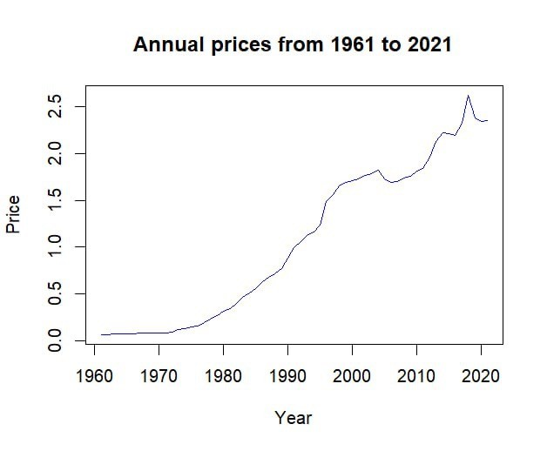
EDA: price of the Wine

Slide 9

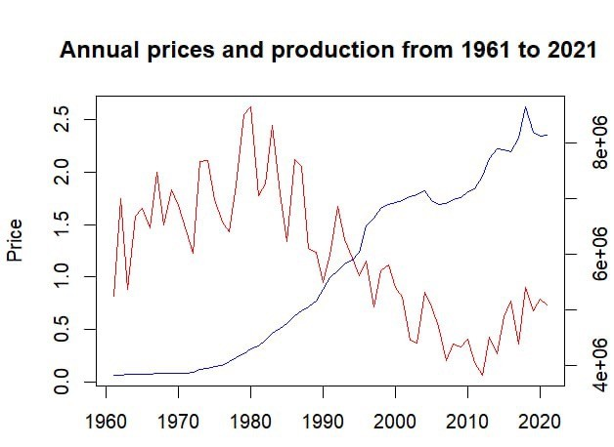
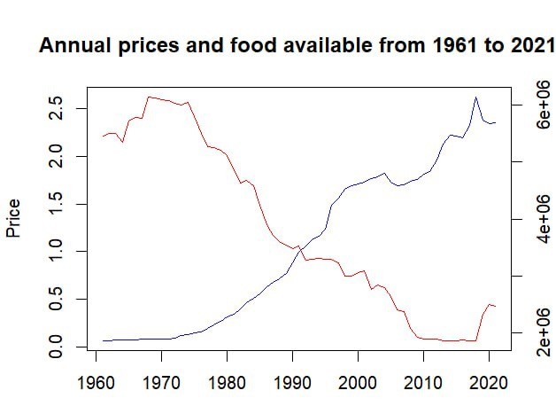
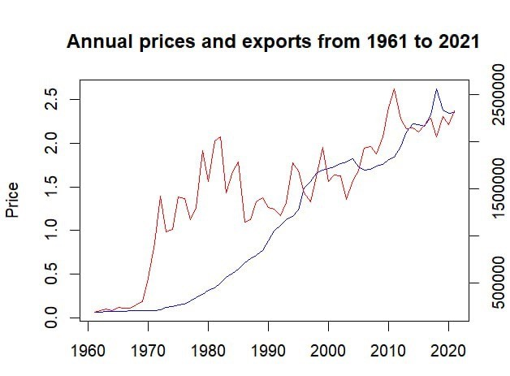
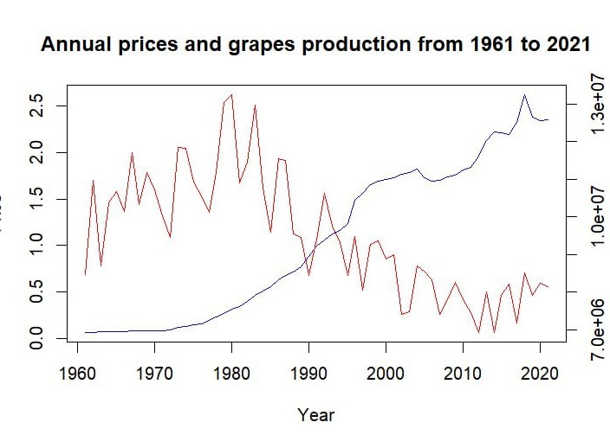
EDA:
combined plots
Regressor
Wine Price

Slide 10


1986, the scandal

Slide 11
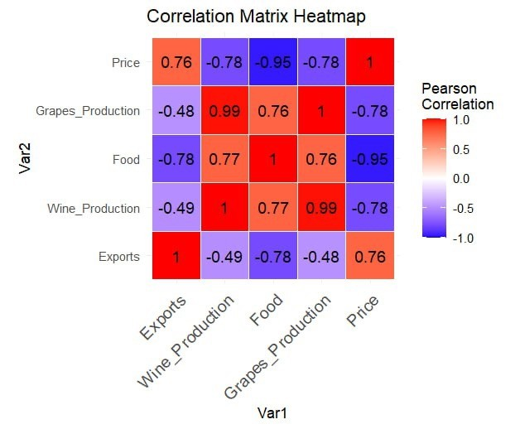
Correlation matrix
Exports and Price: Strong positive correlation (0.76)
Food and Price: Strong negative correlation (-0.95)
Grapes and Wine Production: Very high positive correlation (0.99)

Slide 12
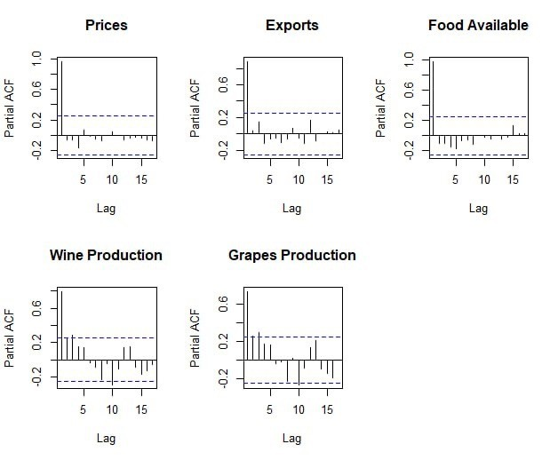
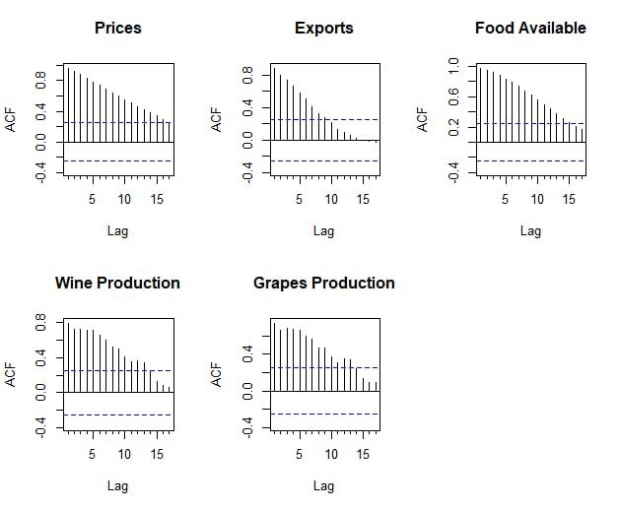
ACF and PACF for every regressor
ACF: Prices & Exports: Gradual linear decay, indicating autocorrelation
PACF: Prices & Exports: Significant first lag, diminishing afterwards.

Slide 13
Train and Test Set
 |  |  |  |  | 55 observations
 |  | Train Set:
 |  |  |  |  | 91.67% of the data
 |  |  | 5 observations
Test Set:
 |  |  | 8.33% of the data

Slide 14


Modelling the data

Slide 15
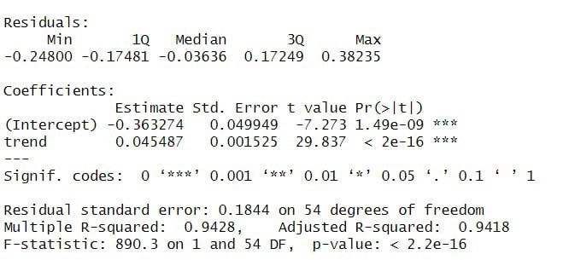

Linear model with trend
MAPE = 6.65 %

Slide 16
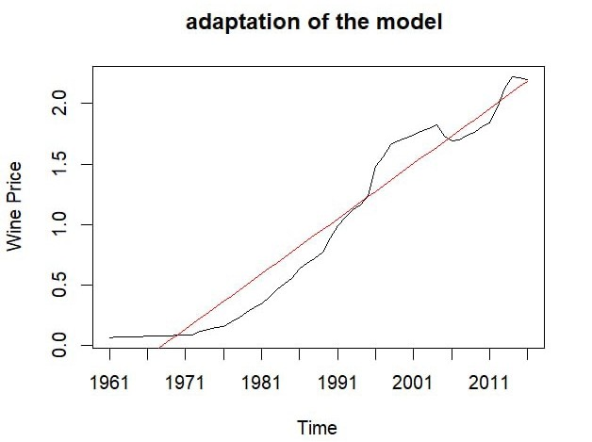
Linear model with trend

Slide 17
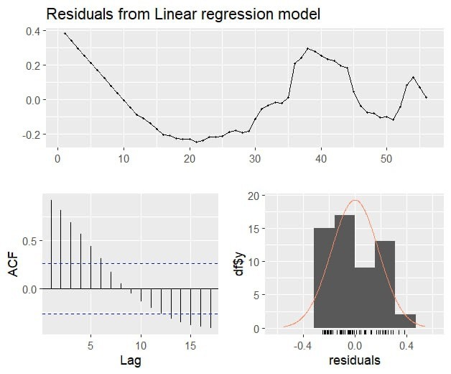
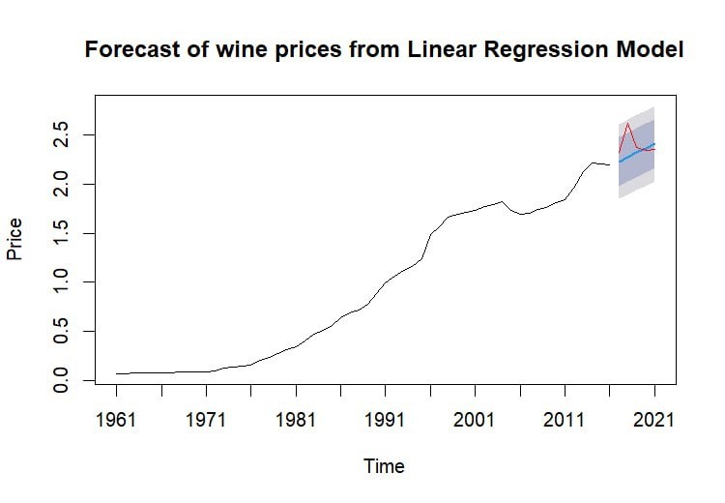
Linear model with trend

Slide 18
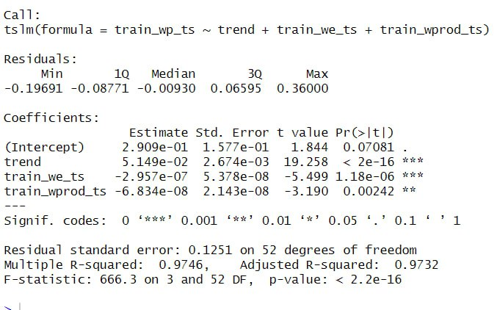
Linear model + trend + regressors
Why this regressor?
MAPE = 4.2 %

Slide 19
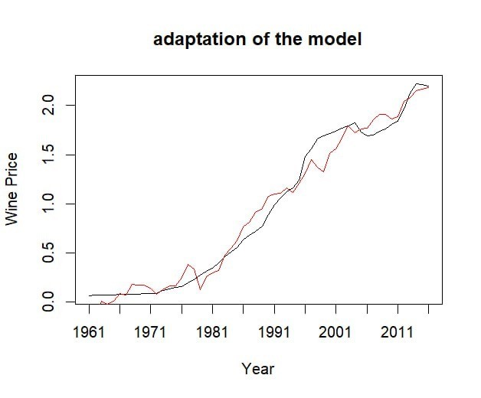
Linear model + trend + regressors

Slide 20
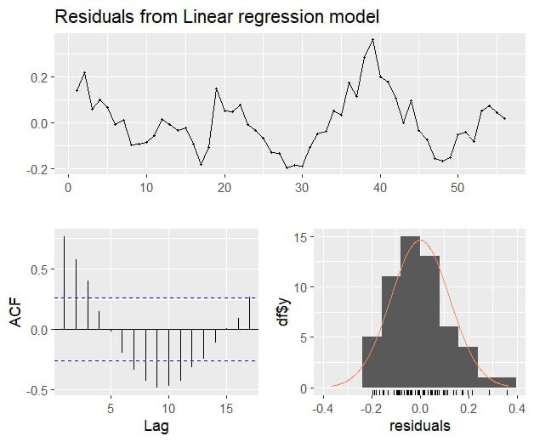
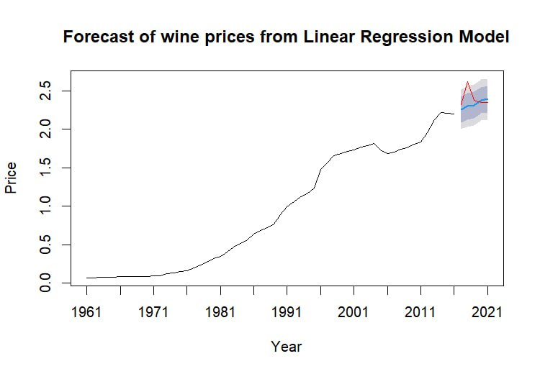
Linear model + trend + regressors

Slide 21

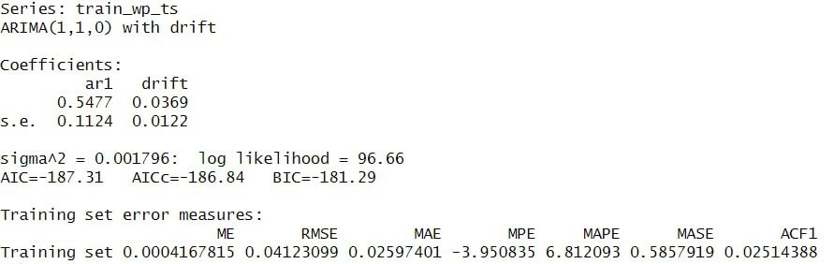
MAPE = 5.4 %
ARIMA (1,1,0)

Slide 22
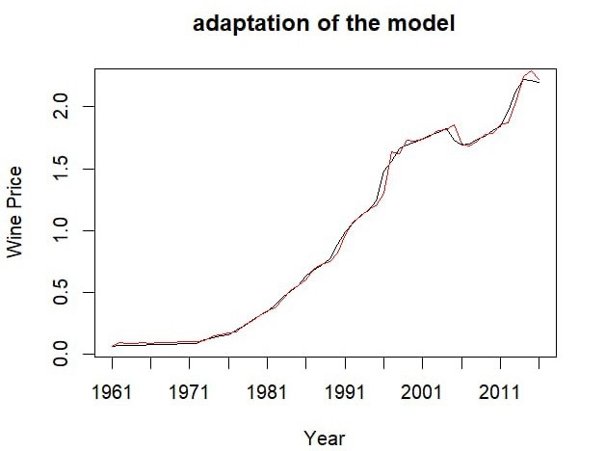
ARIMA (1,1,0)

Slide 23
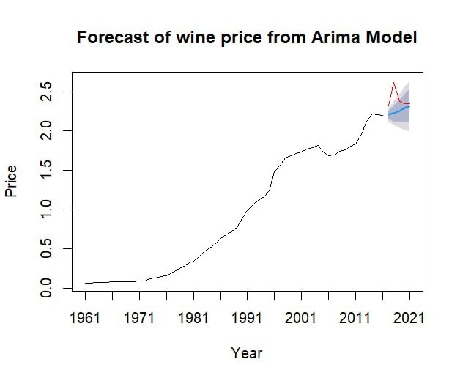
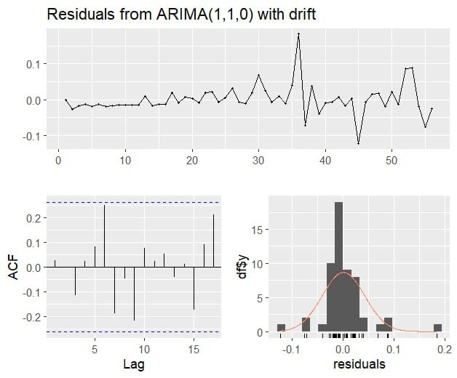
ARIMA(1,1,0)

Slide 24
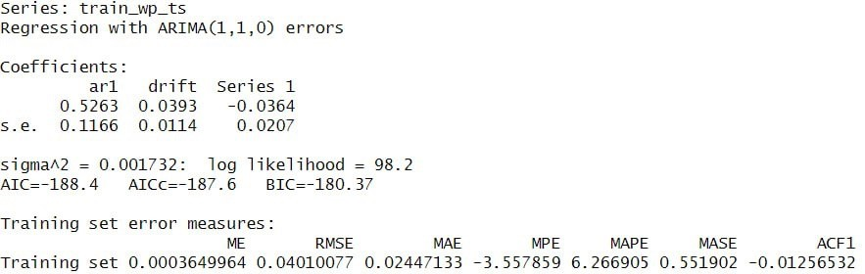
ARMAX WITH ARIMA(1,1,0) ERRORS
MAPE = 4.10 %

Slide 25

ARMAX WITH ARIMA(1,1,0) ERRORS

Slide 26
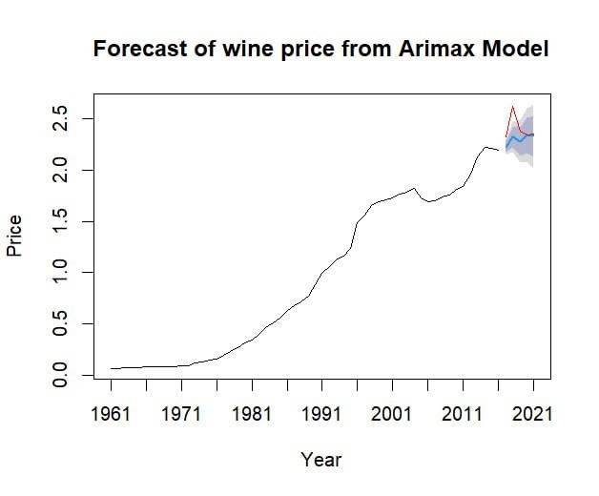
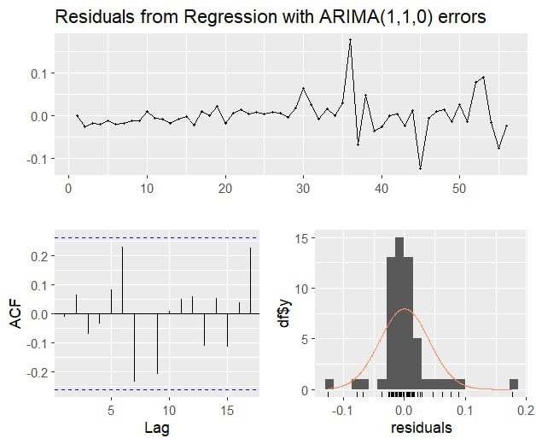
ARMAX WITH ARIMA(1,1,0) ERRORS

Slide 27
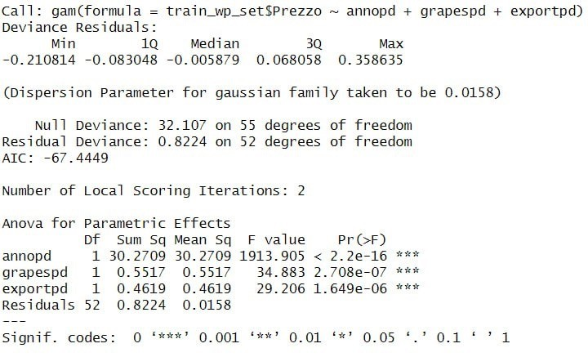
GAM WITH SPLINES ON COVARIATES

Slide 28
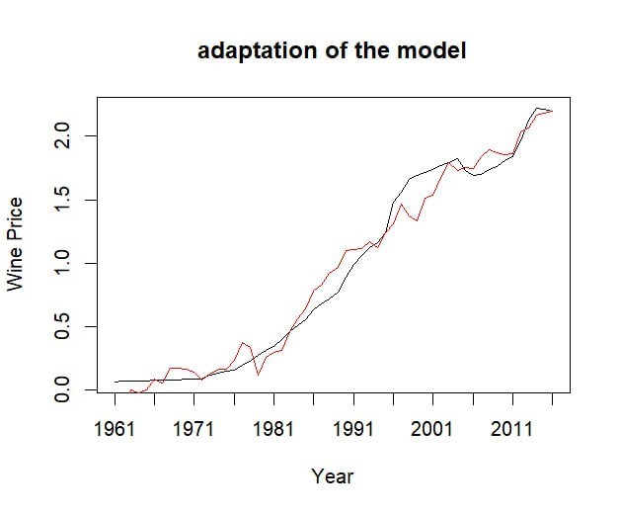
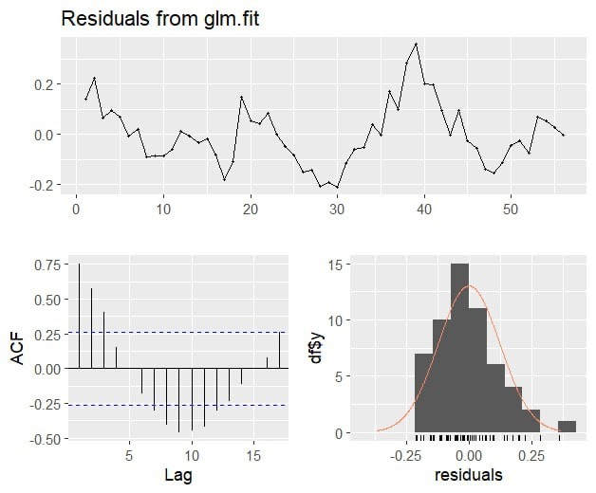
MAPE = 4.01 %
GAM WITH SPLINES ON COVARIATES

Slide 29
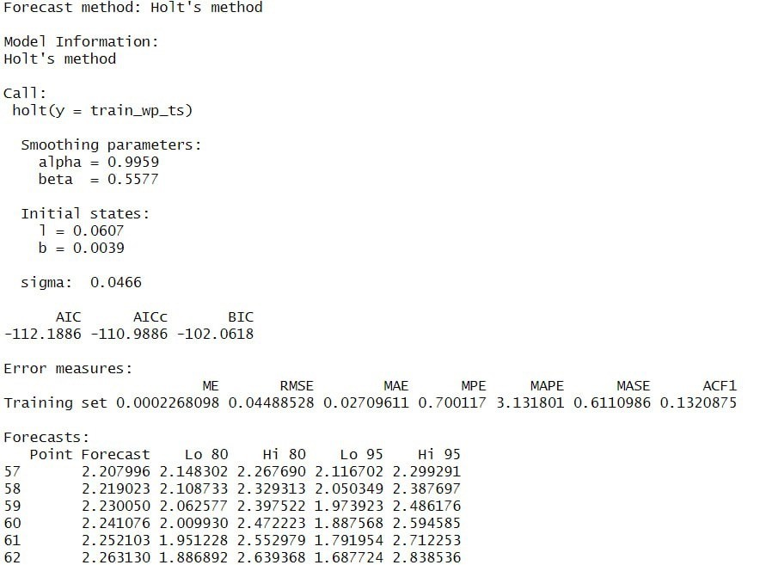
Holt’s method

Slide 30
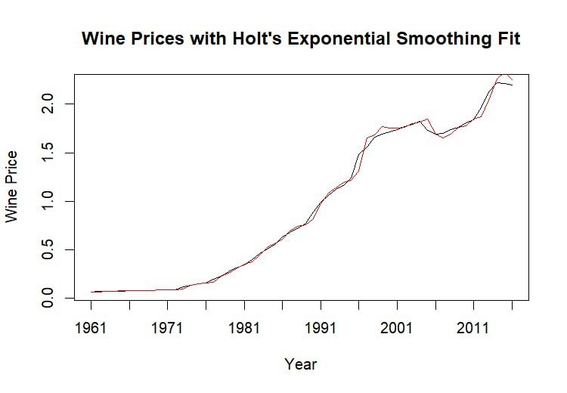
Holt’s method
MAPE = 5.9 %

Slide 31
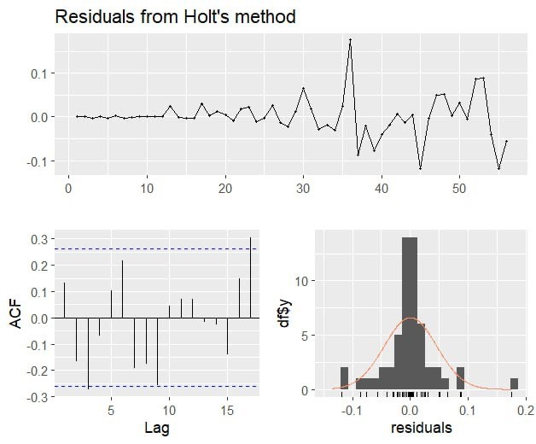
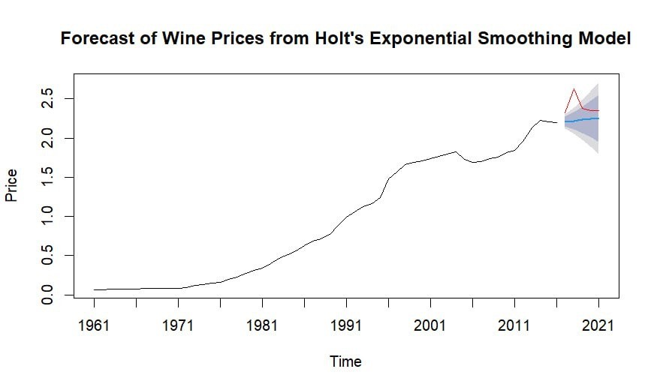
Holt’s method

Slide 32

RESULTS FROM WINE ANALYSIS

Slide 33
Summary Table
Model | Adjusted R² | RMSE | AIC | MAPE
Linear model + trend | 0.9418 | 0.17 | -26.4707 | 6.65%
Linear model + trend + regressor | 0.973 | 0.15 | -68.02 | 4.2%
ARIMA | NA | 0.18 | -187.31 | 5.4%
ARMAX | NA | 0.14 | -188.4 | 4.10%
GAM with spline | 0.97 | 0.14 | -67.49 | 4.01%
Holt’s method | 0.99 | 0.2 | -112 | 5.9%

Slide 34

FORECASTS ON WINE PRICES

Slide 35
What model did we choose?
01
Model with best performance overall: ARMAX
02
We need the regressor
(Wine exports)
03
Test of all the previous models to obtain the best possible forecasted value for the regressor

Slide 36
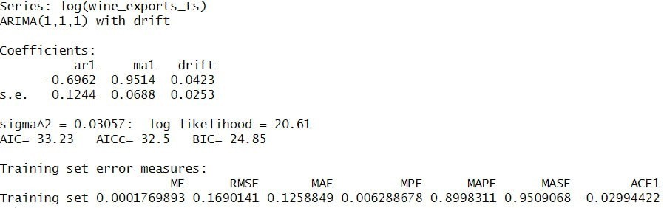
 | Year | Forecast
 | 2022 | 14.77658
 | 2023 | 14.76818
 | 2024 | 14.84583
 | 2025 | 14.86357
 | 2026 | 14.92303
Forecast of the regressor
ARIMA Model the best model for the forecast of the regressor (Wine exports)

Slide 37
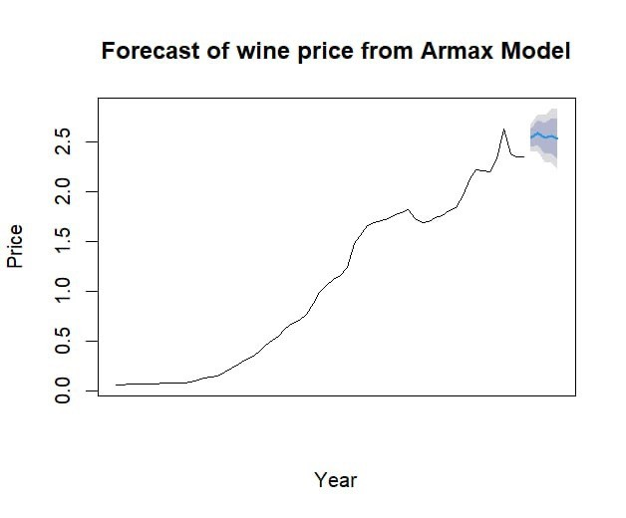
Our forecasts
Year | Forecast
2022 | 2.535976
2023 | 2.589097
2024 | 2.534590
2025 | 2.555073
2026 | 2.523753
general upward trend with some fluctuations

Slide 38

Conclusions on wine analysis

Slide 39

Conclusions
Italy remains one of the world's leading wine producers and exporters, with the wine sector playing a vital role in its economy, evidenced by a significant trade surplus and growing export values.
ARMAX model with ARIMA(1,1,0) errors emerged as the best performer, with a Mean Absolute Percentage Error (MAPE) of 4.10%. This model effectively utilized wine exports as a regressor to forecast future prices.
Using our chosen model, we forecasted wine prices from 2022 to 2026. The predictions indicate a stable trend with slight fluctuations, providing valuable insights for stakeholders in the wine industry.

Slide 40

Future Work
Incorporate Additional Variables
Climate data
Consumer preferences
Economic indicators
Expand Dataset
Add data from other wine-producing countries
Model Enhancement
Experiment with advanced machine learning models
Policy and Market Impact Analysis
Study the impact of government policies

Slide 41

Thank you for the attention

